Slide 1
Validation Based Protocol

Slide 2
Validation Based Protocol is also called Optimistic Concurrency Control Technique. This protocol is used in DBMS (Database Management System) for avoiding concurrency in transactions.
It is called optimistic because of the assumption it makes, i.e. very less interference occurs, therefore, there is no need for checking while the transaction is executed.
In this technique, no checking is done while the transaction is been executed. Until the transaction end is reached updates in the transaction are not applied directly to the database.
All updates are applied to local copies of data items kept for the transaction.
At the end of transaction execution, while execution of the transaction, a validation phase checks whether any of transaction updates violate serializability.
If there is no violation of serializability the transaction is committed and the database is updated; or else, the transaction is updated and then restarted.

Slide 3
Optimistic Concurrency Control is a three-phase protocol. The three phases for validation based protocol:
Read Phase:
In this phase, the transaction T is read and executed. It is used to read the value of various data items and stores them in temporary local variables. It can perform all the write operations on temporary variables without an update to the actual database.
Validation Phase:
In this phase, the temporary variable value will be validated against the actual data to see if it violates the serializability.
Write Phase:
If the validation of the transaction is validated, then the temporary results are written to the database or system otherwise the transaction is rolled back.

Slide 4
In order to perform the Validation test, each transaction should go through the various phases as described above. Then, we must know about the following three time-stamps that we assigned to transaction T_{i}, to check its validity:
1. Start(T_{i}): It is the time when T_{i} started its execution.
2. Validation(T_{i}): It is the time when T_{i} just ﬁnished its read phase and begin its validation phase.
3. Finish(T_{i}): the time when T_{i} end it’s all writing operations in the database under write-phase.
Two more terms that we need to know are:
1. Write_set: of a transaction contains all the write operations that T_{i} performs.
2. Read_set: of a transaction contains all the read operations that T_{i} performs.

Slide 5
In the Validation phase for transaction T_{i} the protocol inspect that T_{i} doesn’t overlap or intervene with any other transactions currently in their validation phase or in committed. The validation phase for T_{i} checks that for all transaction T_{j} one of the following below conditions must hold to being validated or pass validation phase:
1. Finish(T_{j})<Starts(T_{i}), since T_{j} finishes its execution means completes its write-phase before T_{i} started its execution(read-phase). Then the serializability indeed maintained.
2. FinishT_{i} begins its write phase after T_{j} completes its write phase, and the read_set of T_{i} should be disjoint with write_set of T_{j}.
3. T_{j} completes its read phase before T_{i} completes its read phase and both read_set and write_set of T_{i} are disjoint with the write_set of T_{j}.

Slide 6
Ex: Here two Transactions T_{i} and T_{j} are given, since TS(T_{j})<TS(T_{i}) so the validation phase succeeds in the Schedule-A. It’s noteworthy that the final write operations to the database are performed only after the validation of both Ti and T_{j}. Since T_{i} reads the old values of x(12) and y(15) while print(x+y) operation unless final write operation take place.

Slide 7
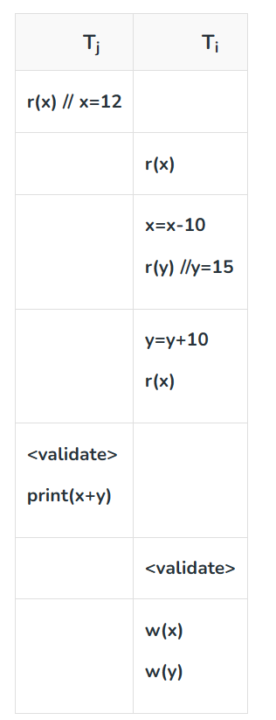
Schedule-A
Schedule-A is a validated schedule

Slide 8
Advantages:
1. Avoid Cascading-rollbacks: This validation based scheme avoid cascading rollbacks since the final write operations to the database are performed only after the transaction passes the validation phase. If the transaction fails then no updation operation is performed in the database. So no dirty read will happen hence possibilities cascading-rollback would be null.
2. Avoid deadlock: Since a strict time-stamping based technique is used to maintain the specific order of transactions. Hence deadlock isn’t possible in this scheme.
Disadvantages:
1. Starvation: There might be a possibility of starvation for long-term transactions, due to a sequence of conﬂicting short-term transactions that cause the repeated sequence of restarts of the long-term transactions so on and so forth. To avoid starvation, conﬂicting transactions must be temporarily blocked for some time, to let the long-term transactions to ﬁnish.

